Slide 1
FDP on LP-I Artificial intelligence and Robotics

Slide 2
Contents
Heuristic search techniques
1. BFS
2. A* algorithm
3. Hill Climbing Algorithm
Goal Stack Planning
Chat Bot
Medical Expert System

Slide 3
Heuristic search techniques
BFS- Best First Search
A* Algorithm
Hill Climbing

Slide 4
Best-First Search
Combines the advantages of Breadth-First and Depth-First searches.
DFS: follows a single path, don’t need to generate all competing paths.
BFS: doesn’t get caught in loops or dead-end-paths.
Best First Search: explore the most promising path seen so far.

Slide 5
Best-First Search (cont.)
While goal not reached:
1. Generate all potential successor states and add to a list of states.
2. Pick the best state in the list and go to it.
Similar to steepest-ascent, but don’t throw away states that are not chosen.
Notes:
Space requirements are a problem...
Modified version called “beam search” keeps on the N most promising states around.

Slide 6
A* Algorithm
The A* algorithm uses a modified evaluation function and a Best-First search.
A* minimizes the total path cost.
Under the right conditions A* provides the cheapest cost solution in the optimal time!

Slide 7
A* evaluation function
The evaluation function f is an estimate of the value of a node x given by:
f(x) = g(x) + h’(x)
g(x) is the cost to get from the start state to state x.
h’(x) is the estimated cost to get from state x to the goal state (the heuristic).
Notes:
Some notes about g and h’
If g is 0, this is just a greedy algorithm - it always picks what looks like the most promising path to the goal.
If h’ is 0 and g is always 1, the search will be a breadth first search, since the cost of each path will be the length of the path.

Slide 8
A* Optimality and Completeness
If the heuristic function h’ is admissible the algorithm will find the optimal (shortest path) to the solution in the minimum number of steps possible (no optimal algorithm can do better given the same heuristic).
An admissible heuristic is one that never overestimates the cost of getting from a state to the goal state (is pessimistic).

Slide 9
Hill Climbing
Variation on generate-and-test:
generation of next state depends on feedback from the test procedure.
Test now includes a heuristic function that provides a guess as to how good each possible state is.
There are a number of ways to use the information returned by the test procedure.
Notes:
The term hill climbing assumes we are talking about finding a maximum, but the concepts apply to minimization problems as well.
Remember that the heuristic is a rule of thumb or guess based on less than complete information. We assume that construction of a perfect heuristic is impossible (otherwise it would be the search).

Slide 10
Simple Hill Climbing
Use heuristic to move only to states that are better than the current state.
Always move to better state when possible.
The process ends when all operators have been applied and none of the resulting states are better than the current state.
Hill climbing does not look ahead of the immediate neighbors of the current state.
Can randomly choose among the set of best successors, if multiple have the best value
Characterized as “trying to find the top of Mount Everest while in a thick fog”
Notes:
Always climb uphill whenever you can, without looking around.
Climbing a mountain in the dark - test one direction and if it is uphill take a step in that direction. If you find that there is no uphill move in any direction you are done (at the top of the mountain).

Slide 11
Hill-climbing search
function HILL-CLIMBING( problem) return a state that is a local maximum
input: problem, a problem
local variables: current, a node.
neighbor, a node.
current ← MAKE-NODE(INITIAL-STATE[problem])
loop do
neighbor ← a highest valued successor of current
if VALUE [neighbor] ≤ VALUE[current] then return STATE[current]
current ← neighbor

Slide 12
Hill-climbing example
8-queens problem, complete-state formulation
All 8 queens on the board in some configuration
Successor function:
move a single queen to another square in the same column.
Example of a heuristic function h(n):
the number of pairs of queens that are attacking each other (directly or indirectly)

Slide 13
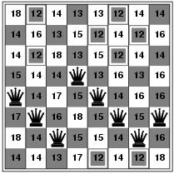
Hill-climbing example
(c₁ c₂ c₃ c₄ c₅ c₆ c₇ c₈) = (5 6 7 4 5 6 7 6)
Current state: h=17

Slide 14
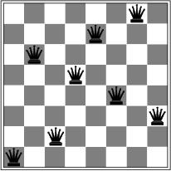
A local minimum for 8-queens
A local minimum in the 8-queens state space (h=1)

Slide 15
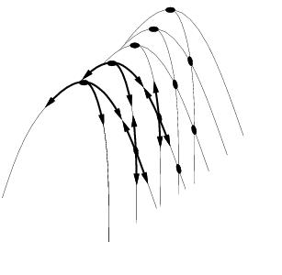
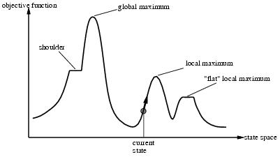
Other drawbacks
Ridge = sequence of local maxima difficult for greedy algorithms to navigate
Plateau = an area of the state space where the evaluation function is flat.

Slide 16
Hill climbing and local maxima
When local maxima exist, hill climbing is suboptimal
Simple (often effective) solution
Multiple random restarts

Slide 17
Hill Climbing Termination
Local Optimum: all neighboring states are worse or the same.
Plateau - all neighboring states are the same as the current state.
Ridge - local optimum that is caused by inability to apply 2 operators at once.
Notes:
Example of ridge is clear in the water jug problem.
Need to define a heuristic for the water jug problem that takes this in to account.

Slide 18
Goal Stack Planning
Problem-solving is searching and moving through a state space.
Planning is searching for successful paths through a state space
Planning = problem solving in advance.
Planning is important if solutions cannot be undone.
If the universe is not predictable, then a plan can fail dynamic plan revision.

Slide 19
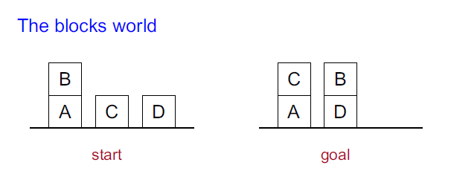
Continued...
Planning = generating a sequence of actions to
achieve the goal from the start

Slide 20
Continued...
Actions:
1. UNSTACK(A, B)
2. STACK(A, B)
3. PICKUP(A)
4. PUTDOWN(A)

Slide 21
Continued...
Conditions and results:
1. ON(A, B)
2. ONTABLE(A)
3. CLEAR(A)
4. HOLDING(A)
5. ARMEMPTY

Slide 22
Chat Bot
Known as talkbot, chatterbot or interactive agent.
Conducts conversation via textual methods.
e.g. Google Assistant, Siri Interactive Agent
Focuses on NLP, NLU and NLG

Slide 23
AIML(Artificial intelligence Markup Language)
Important AIML Tags used in AIML documents
<aiml>
<category>
<pattern>
<template>

Slide 24
Other Used Tags are:
<star>: match wild card*characters in <pattern>tag.
<srai> : Different targets with same template.
<set> and <get> : Used to work with variables in aiml.
<random> : To get random response.
<topic> : Tag is used in AIML to store a context so that later conversation can be done based on that context.

Slide 25
Sample Program
<aiml version = "1.0.1" encoding = "UTF-8"?> <category> <pattern> HELLO ALICE </pattern> <template> Hello User! </template> </category> </aiml>
<aiml> tag signifies start of the AIML document.
<category> tag defines the knowledge unit.
<pattern> tag defines the pattern user is going to type.
<template> tag defines the response to the user if user types Hello Alice.

Slide 26
Medical Expert System
A system that uses human expertise to make complicated decisions.
Simulates reasoning by applying knowledge and interfaces.
Uses expert’s knowledge as rules and data within the system.
Models the problem solving ability of a human expert.

Slide 27
Components of an ES
Knowledge Base
Reasoning or Inference Engine
User Interface
Explanation Facility

Slide 28
User Interface
Allows the expert system and the user to communicate.
Finds out what it is that the system needs to answer.
Sends the user questions or answers and receives their response.

Slide 29
Explanation Facility
Explains the systems reasoning and justifies its conclusions.

Slide 30
Knowledge Base
Represents all the data and information imputed by experts in the field.
Stores the data as a set of rules that the system must follow to make decisions.

Slide 31
Inference Engine
Asks the user questions about what they are looking for.
Applies the knowledge and the rules held in the knowledge base.
Appropriately uses this information to arrive at a decision.

Slide 32
Prolog
Short form for Programming Logic
Prolog was one of the early languages used for artificial intelligence applications, particularly expert systems.
The reason why Prolog is considered powerful in AI is because the language allows for easy management of recursive methods, and pattern matching.

Slide 33
Programming in Prolog
Programming in prolog involves
Declare facts describing explicit relationships between objects and properties objects might have
e.g. Mary likes pizza
Define rules defining implicit relationships between objects
e.g. X is a parent if there is a Y such that Y is a child of X

Slide 34
Prolog Variables
Suppose we want to ask, "What course does Turing teach"?
This could be written as:
Is there a course, X, that Turing teaches?
The variable X stands for an object that the questioner does not know about yet.

Slide 35
Prolog applications
Some applications of Prolog are:
Intelligent database retrieval
Natural language understanding
Expert systems
Specification language
Machine learning
Robot planning
Automated reasoning
Problem solving

Slide 36
Thank You

